Slide 1







The Assessment of Risk and Return in capital investment decisions
☑
RiskEase Ltd
Assess Risk with Ease

Slide 2

RiskEase Ltd
Professional Software and Consulting services in Investment Appraisal, Risk Analysis and Project Finance
Website:
www.riskease.com
RiskEase Ltd ©

Slide 3

The RiskEase Total Package
RiskEase Software
Financial Modelling Tools
Project Finance Training
(On-the-job Expert Advice)
Practical Expert Solutions
Enhancing Your Professional Competence

Slide 4
The evaluation of capital investment projects and the assessment of risk
1
2
Integrated Financial Model (based on Cost-Benefit Analysis methodology)
Competitiveness
Appraisal
Risk Analysis
Marketing Module
Cash-Flow Projections
Input Data
3
Technical Module
Input Data
Taking aspects of marketing and competitiveness into account to ensure a coherent business plan
Dealing with uncertainty when defining and projecting risk variables
Project Risk Profile
and Financing Structure
4
Notes:
4
4
4
Marketing analysis in project evaluation refers to the methodology by which strategic marketing principles are applied for the purpose of assessing the capability of an investment project to survive the competitive forces in its market. It provides the rules by which the marketing variables in a projected cash flow such as, sales volume, price, distribution and promotion expenses are derived. Marketing analysis also examines the integrity and consistency of the marketing assumptions and, where possible, helps in reformulating the project thereby increasing its likelihood of viability and sustained market performance.

Slide 5

Risk Analysis
Savvakis C. Savvides
using
RiskEase

Slide 6
The Risk Analysis Process and RiskEase
RiskEase was developed as a companion application of the widely popular paper by Savvakis C. Savvides Risk Analysis in Investment Appraisal*.
It was designed to allow the user to easily apply the risk analysis Monte Carlo Simulation methodology as it relates to the assessment of project risk in capital investment projects.
The original software was called RiskMaster. (Initially in 1986 as a Lotus 1-2-3 Add-On and subsequently as RiskMaster for Windows as an Excel Add-In before it was renamed to RiskEase).
The software follows the same process as outlined in the academic paper for applying risk analysis.
The stages of this process are executed sequentially and one stage essentially has to be completed before proceeding to the next one.
* (initially published as a Harvard Institute for International Development DDP - 276 October 1988. 44 pp. and subsequently in the Project Appraisal Journal, Vol. 9, No. 1, March 1994).

Slide 7
The Risk Analysis Process
Risk Analysis in Investment Appraisal

Slide 8

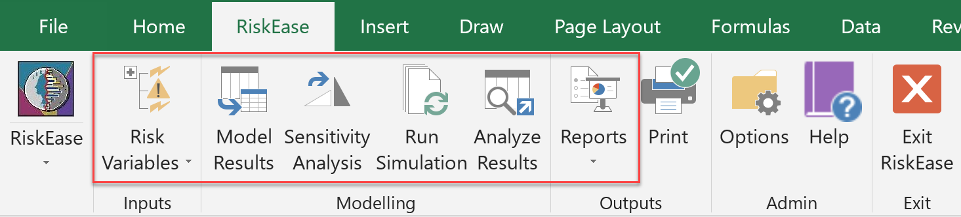
RiskEase Menu
RiskEase - Risk Analysis Stages
Risk Variables
Risk Variables Table (RVT)
Model Results
Sensitivity Analysis
(Optional)
Run Simulation
Simulation Runs Table (SRT)
Analyse Results
Set Probability Distributions
Set Correlations
Set Links
Relative Sensitivity
Absolute Sensitivity
Run Simulation
Table of Statistics
Cumulative charts
Reports
(Optional)
Risk Variables Profile
Model Results Profile
Custom Reports
Confidence Range Plot
Frequency charts
Segmentation Analysis
Set Links

Slide 9

Applying Risk Analysis using RiskEase Master Edition
Easy to use point-and-click interface
Complete sensitivity analysis module
Powerful user interface for editing probability distributions with real-time display
Ability to bend, truncate and apply correlation conditions to probability distributions
Capability to fit probability distributions to user provided data
Probability distribution library
Enhanced analysis module capable of comparing multiple simulation results
Ability to use the software in “real options” situations
Built-in report generator enabling the generation of professional reports
Many other features such as the use of default distributions, new chart formatting options
Demo Video:
https://youtu.be/ihr0__x8SwU

Slide 10
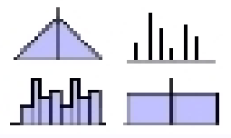
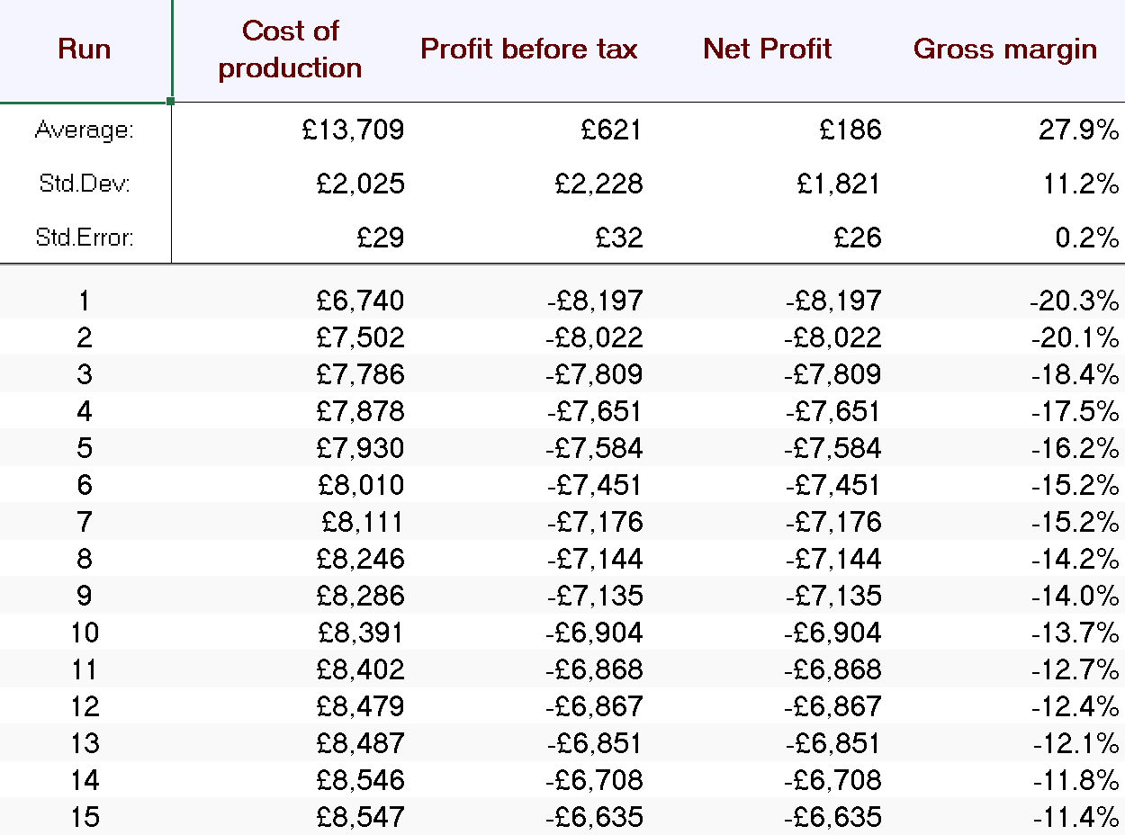
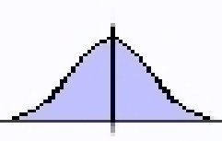
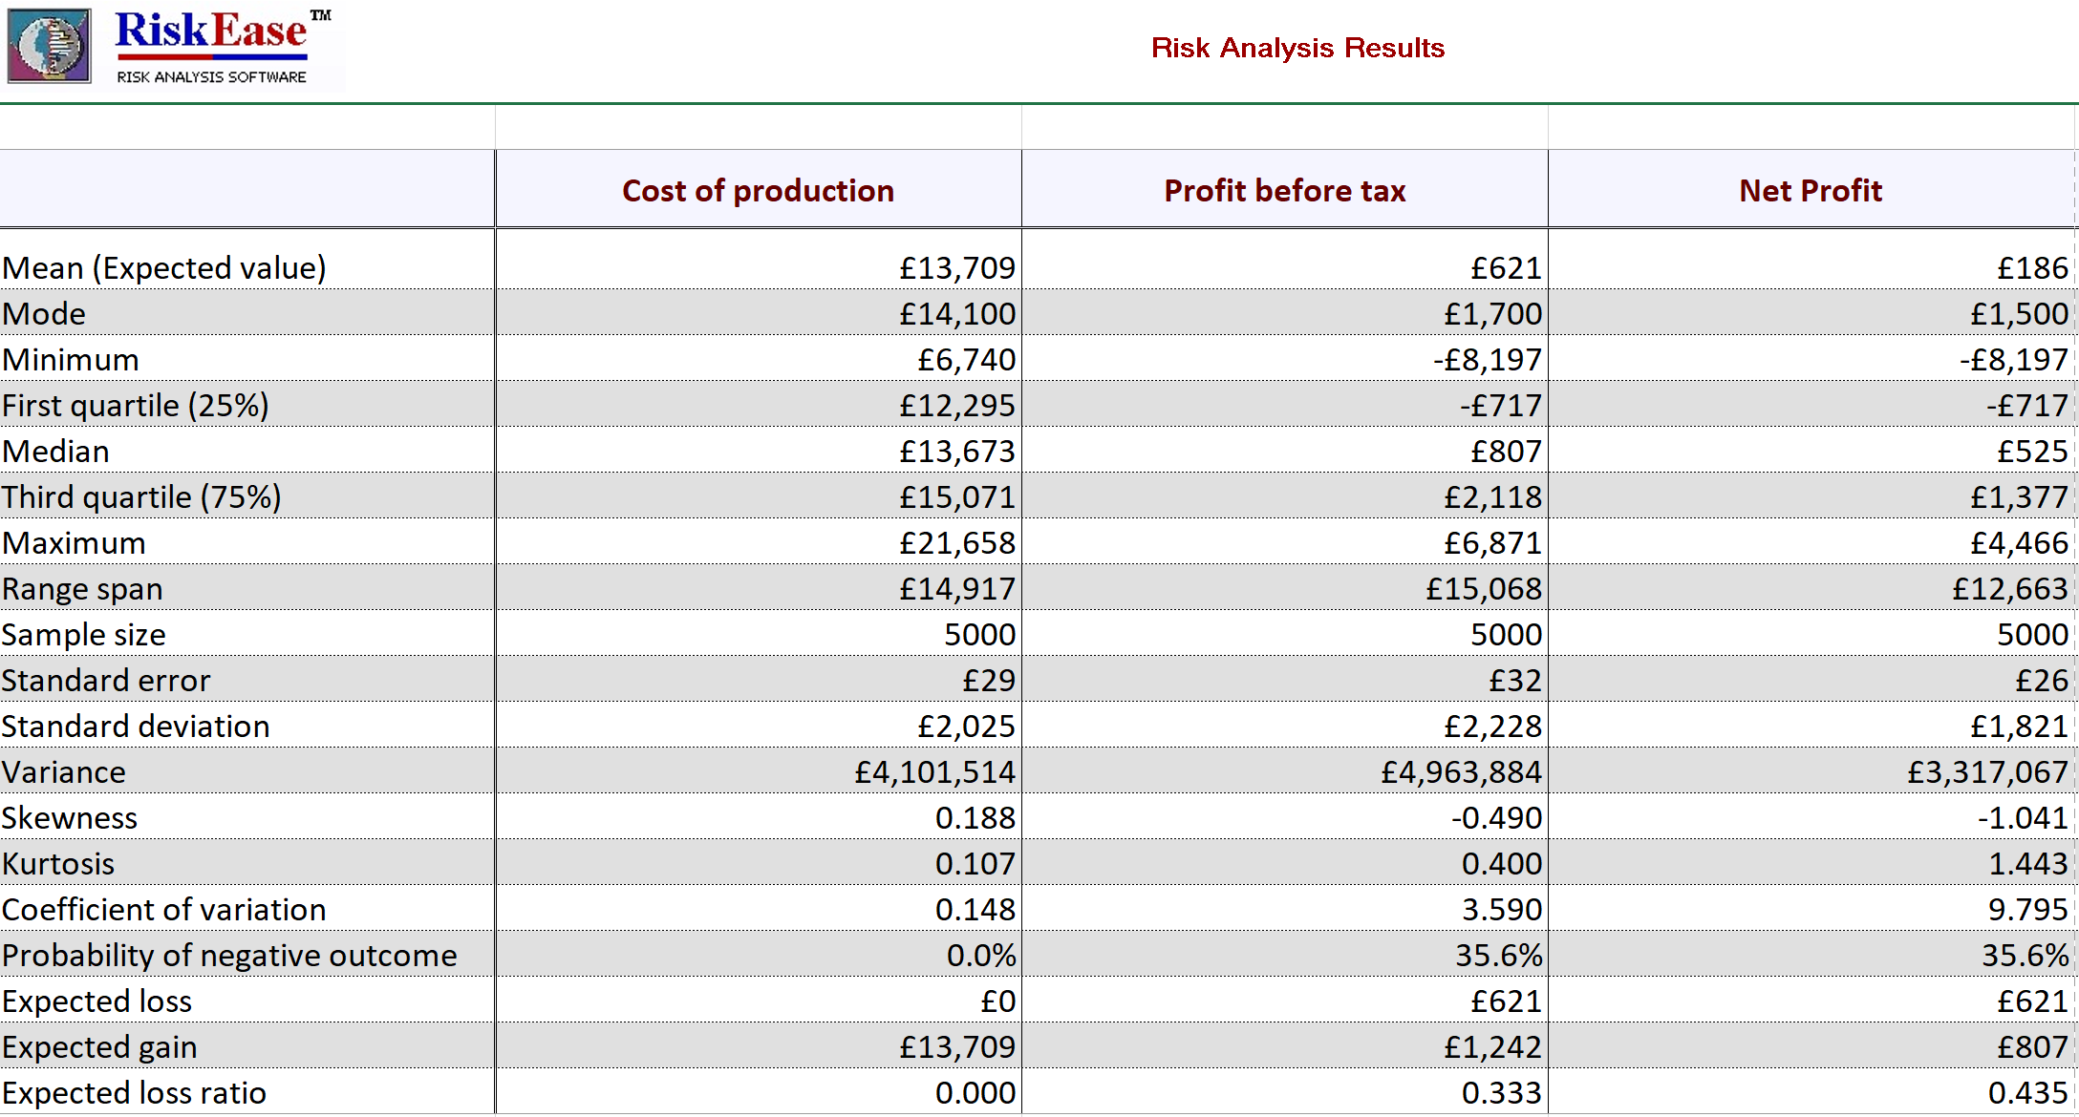
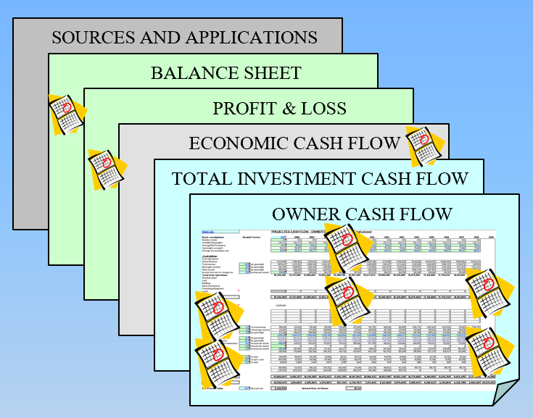
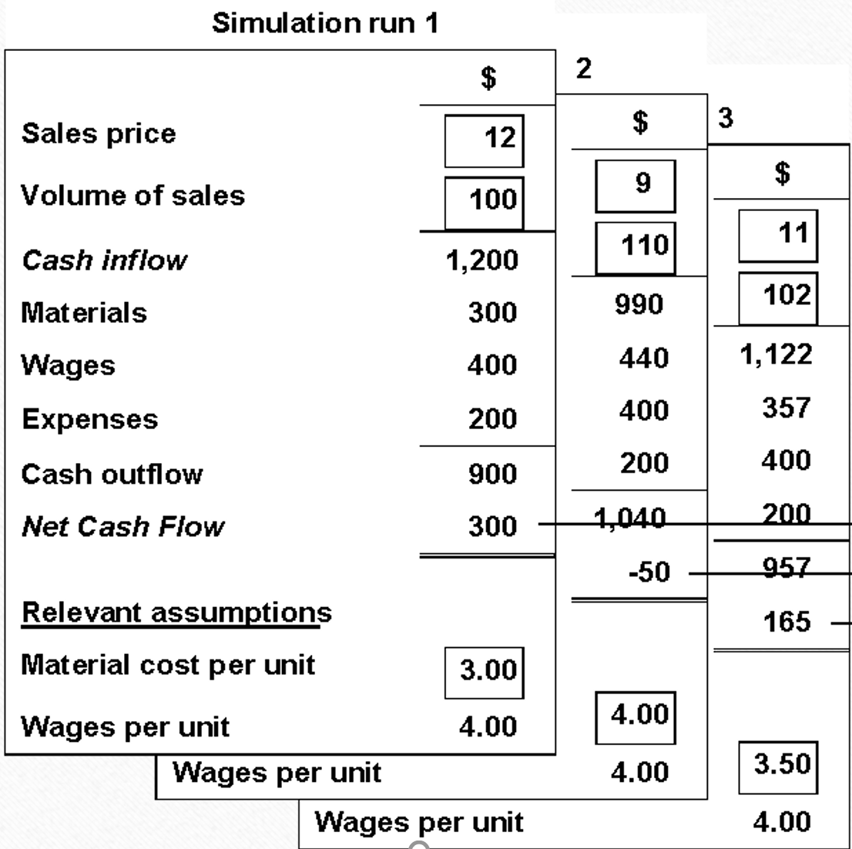
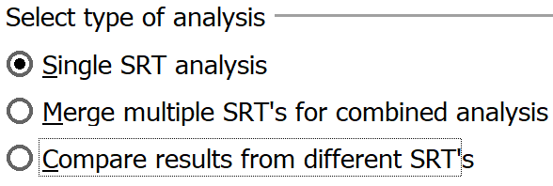
RiskEase Features and Unique Multi Input-Output Design
Inputs
Model
Outputs
Analysis
Reports
RVT 1
SRT 1
25%
25%
RVT 2
25%
SRT 2
25%
Word
PPT
RVT 3
25%
SRT 3
25%
Excel
RVT 4
25%
SRT 4
25%
Prepare with Ease Inputs
Single
Combined
New
Append
Store all scenarios
Export with Ease Reports

Slide 11
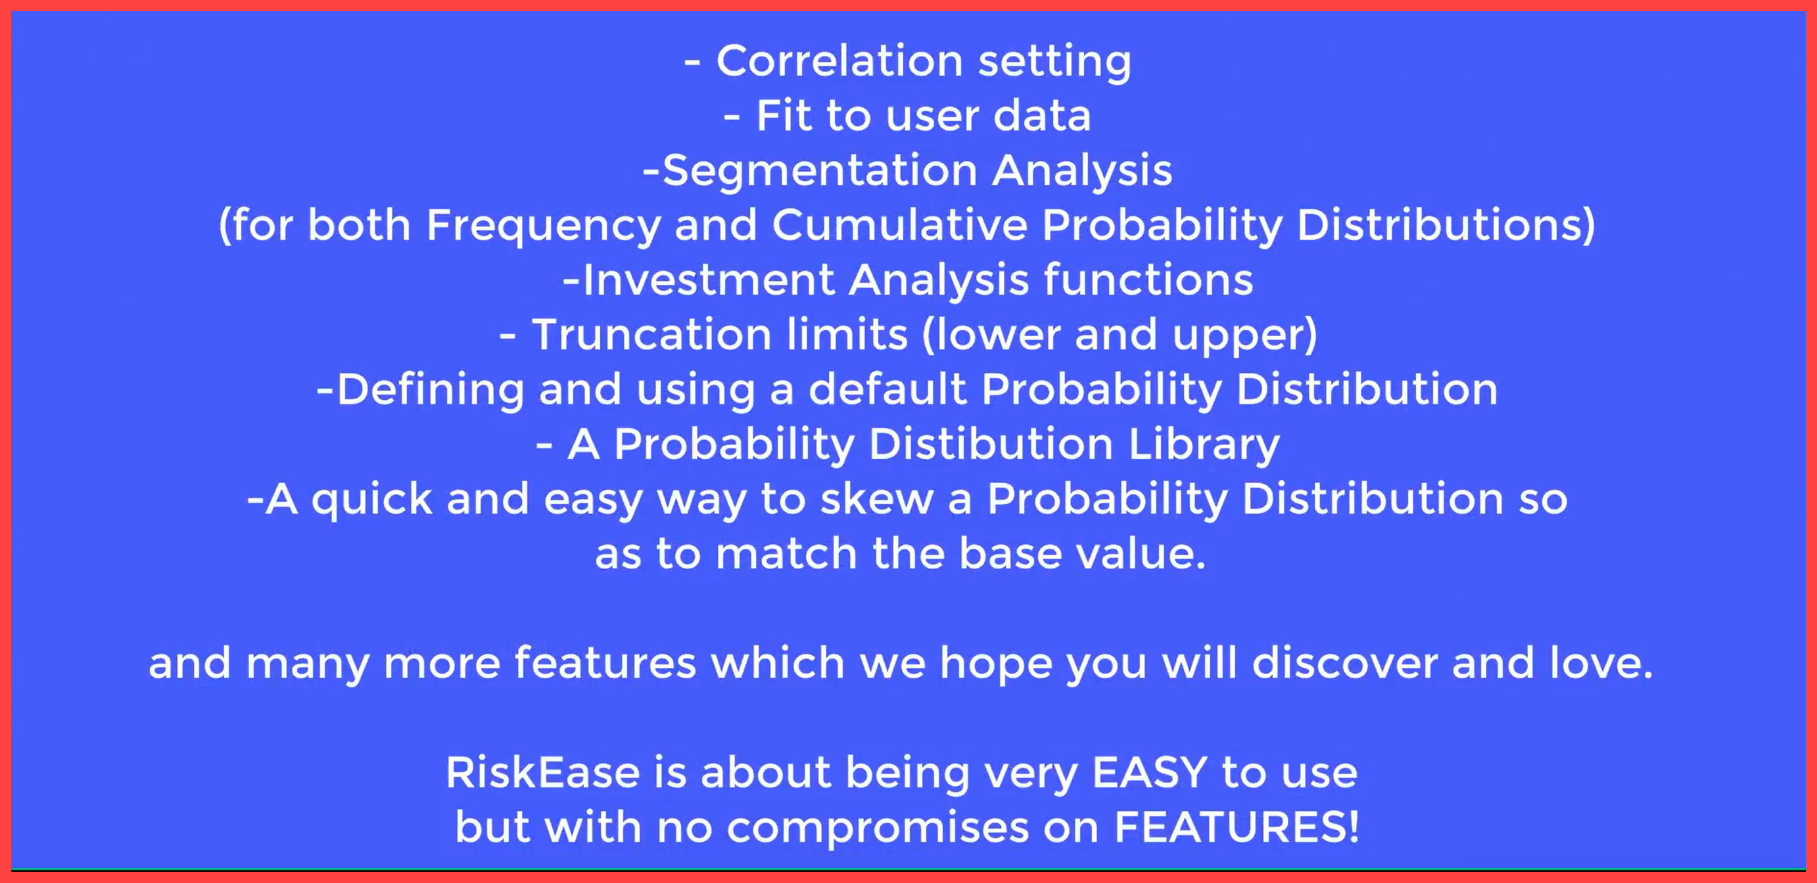
Other Features of RiskEase

Slide 12

The Financial Model
Savvakis C. Savvides
RiskEase Ltd

Slide 13

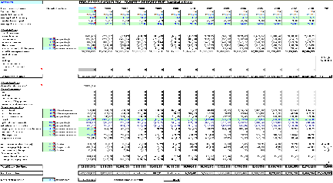
Integrated Financial Model
Savvakis C. Savvides ©
Economic Analysis
Shadow
Prices
Conversion
Factors
Market Analysis
Risk Analysis
Prices
SOURCES AND APPLICATIONS
Model
Results
BALANCE SHEET
PROFIT & LOSS
ECONOMIC CASH FLOW
TOTAL INVESTMENT CASH FLOW
Quantities
OWNER CASH FLOW
Risk
Variables
Project Cost
& Financing
Plan
Loans
Depreciation
Taxation
Assumptions
Supporting Modules
Index:
Hot Links
Reports
Modules

Slide 14
Integrated Financial Model
The Integrated Financial Model© by Savvakis C. Savvides was created and tested after many years of expertise of the author in corporate lending and project finance as well as from teaching investment appraisal and risk analysis and the development of related software.
The Integrated Financial Model is designed so that it offers the user the following benefits:
  To be set up easily and quickly.
  To be coherent and comprehensive.
  To be adaptable with very few changes.
  To be usable for any type or size of project.
  To be well and truly integrated.
  To be driven by a manageable number of important parameters and also to include and accommodate the easy use of a specially designed forecasting Excel Add-In which allows the easy and coherent projections of growth patterns.
  To be ready for Risk Analysis using Monte Carlo Simulation software (such as RiskEase).
  To produce reports of financial cash flow projections from the perspective of various stakeholders, including the owner of the project, the total investment perspective or even to be easily expandable so as application of economic analysis.
  The Model can also quickly be set up to be used for screening promising or even to discard poor and non-viable projects.
  Last, but not least, the model can be attached as a front end to very large and elaborate workbooks to make sense of their useful, but often not so well integrated, content of data.

Slide 15
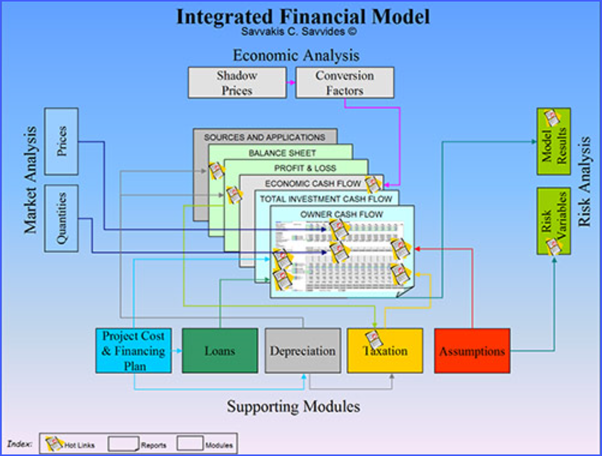
Integrated Financial Model
RiskEase Total Edition
IFM is integrated with RiskEase in the RiskEase Total Edition. It is fully compatible and enhances the capabilities of RiskEase providing a means to a complete solution for professionals involved in investment appraisal and credit risk assessment.
The Integrated Financial Model is currently offered as a service to corporate clients and Universities together with the training programs that support it.

Slide 16
Cost-Benefit Analysis
RiskEase Ltd
Notes:
16
16

Slide 17
COST-BENEFIT ANALYSIS FOR INVESTMENT DECISIONS
Jenkins G. P, C. Y. K Kuo and A.C. Harberger, “Cost-Benefit Analysis for Investment Decisions”, 2011
THE FINANCIAL APPRAISAL OF PROJECTS
  Construction of Financial Cash Flows: Concepts and Principles
  The Investment and Operating Phases
  Cessation of Project Operations and Residual Values
  Format for the Pro-Forma Cash Flow Statement
  Use of Consistent Prices in the Cash Flow Forecast
  Expected Nominal interest and Exchange Rate
  Incorporating Inflation in the Financial Analysis
  Analyses of Investment Decisions from Alternative Viewpoints
  The Banker’s Point of View
  The Owner’s Point of View
  The Economy’s Point of View
  Relationship between Different Points of View – Stakeholder Analysis
DISCOUNTING AND ALTERNATIVE INVESTMENT CRITERIA
  Time Dimension of a Project
  Time Value of Money
  Discounting
  Alternative Investment Criteria
  Net Present Value and Internal Rate of Return Criteria
  Debt Service Coverage Ratios
SCALE, TIMING, LENGTH AND INTER-DEPENDENCIES IN PROJECT SELECTION
  Determination of Scale in Project Selection
  Timing of Investments
  Adjusting for Different Lengths of Life
  Projects with Interdependent and Separable Components

Slide 18
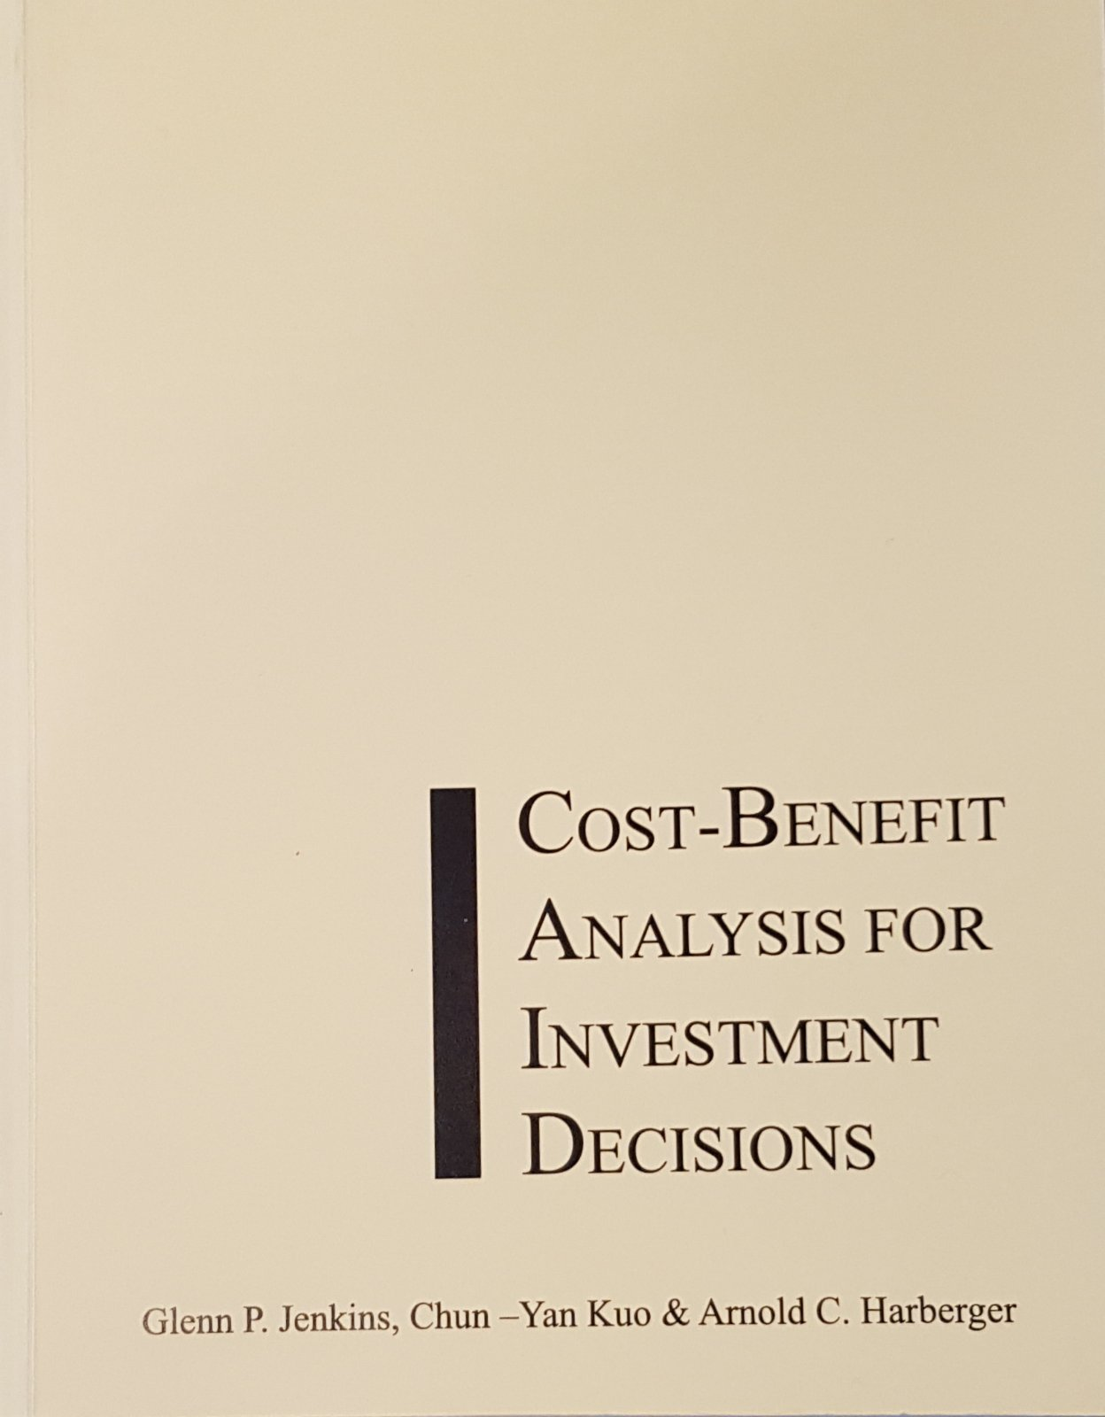
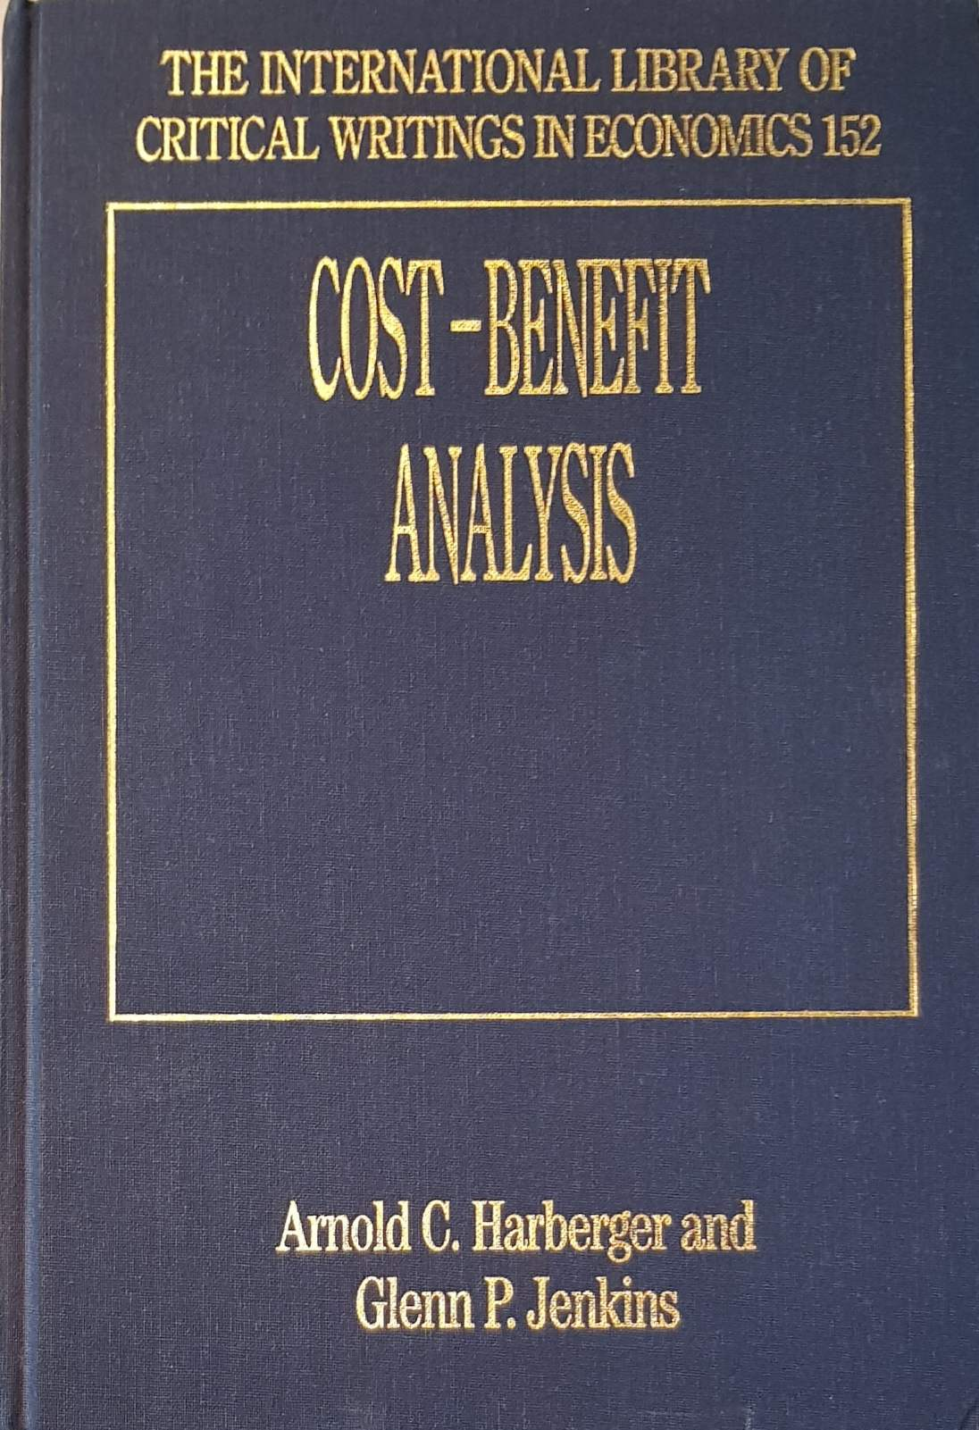
COST-BENEFIT ANALYSIS FOR INVESTMENT DECISIONS
Jenkins G. P, C. Y. K Kuo and A.C. Harberger, “Cost-Benefit Analysis for Investment Decisions”, 2011
THE ECONOMIC ANALYSIS OF PROJECTS
  Objectives for Economic Investment Appraisal
  Postulates Underlying the Economic Evaluation Methodology
  Applying the Postulates to Determine Economic Evaluation of Non-Tradable Goods and Services in an Undistorted Market
  Analysing Economic Costs and Benefits in an Existing Market (in the absence of a new project)
  Analysing the Economic Benefits of an Output Produced by a Project
  Analysing the Economic Cost of an Input Demanded by a Project
  Applying the Postulates to Determine Economic Evaluation of Non-Tradable Goods and Services in Distorted Markets
  Sales Taxes Levied on Output of Project
  Subsidies on Production
  Environmental Externalities
  Other Distortions
  The Economic Opportunity Cost of Capital
  The Economic Opportunity Cost of Labour

Slide 19
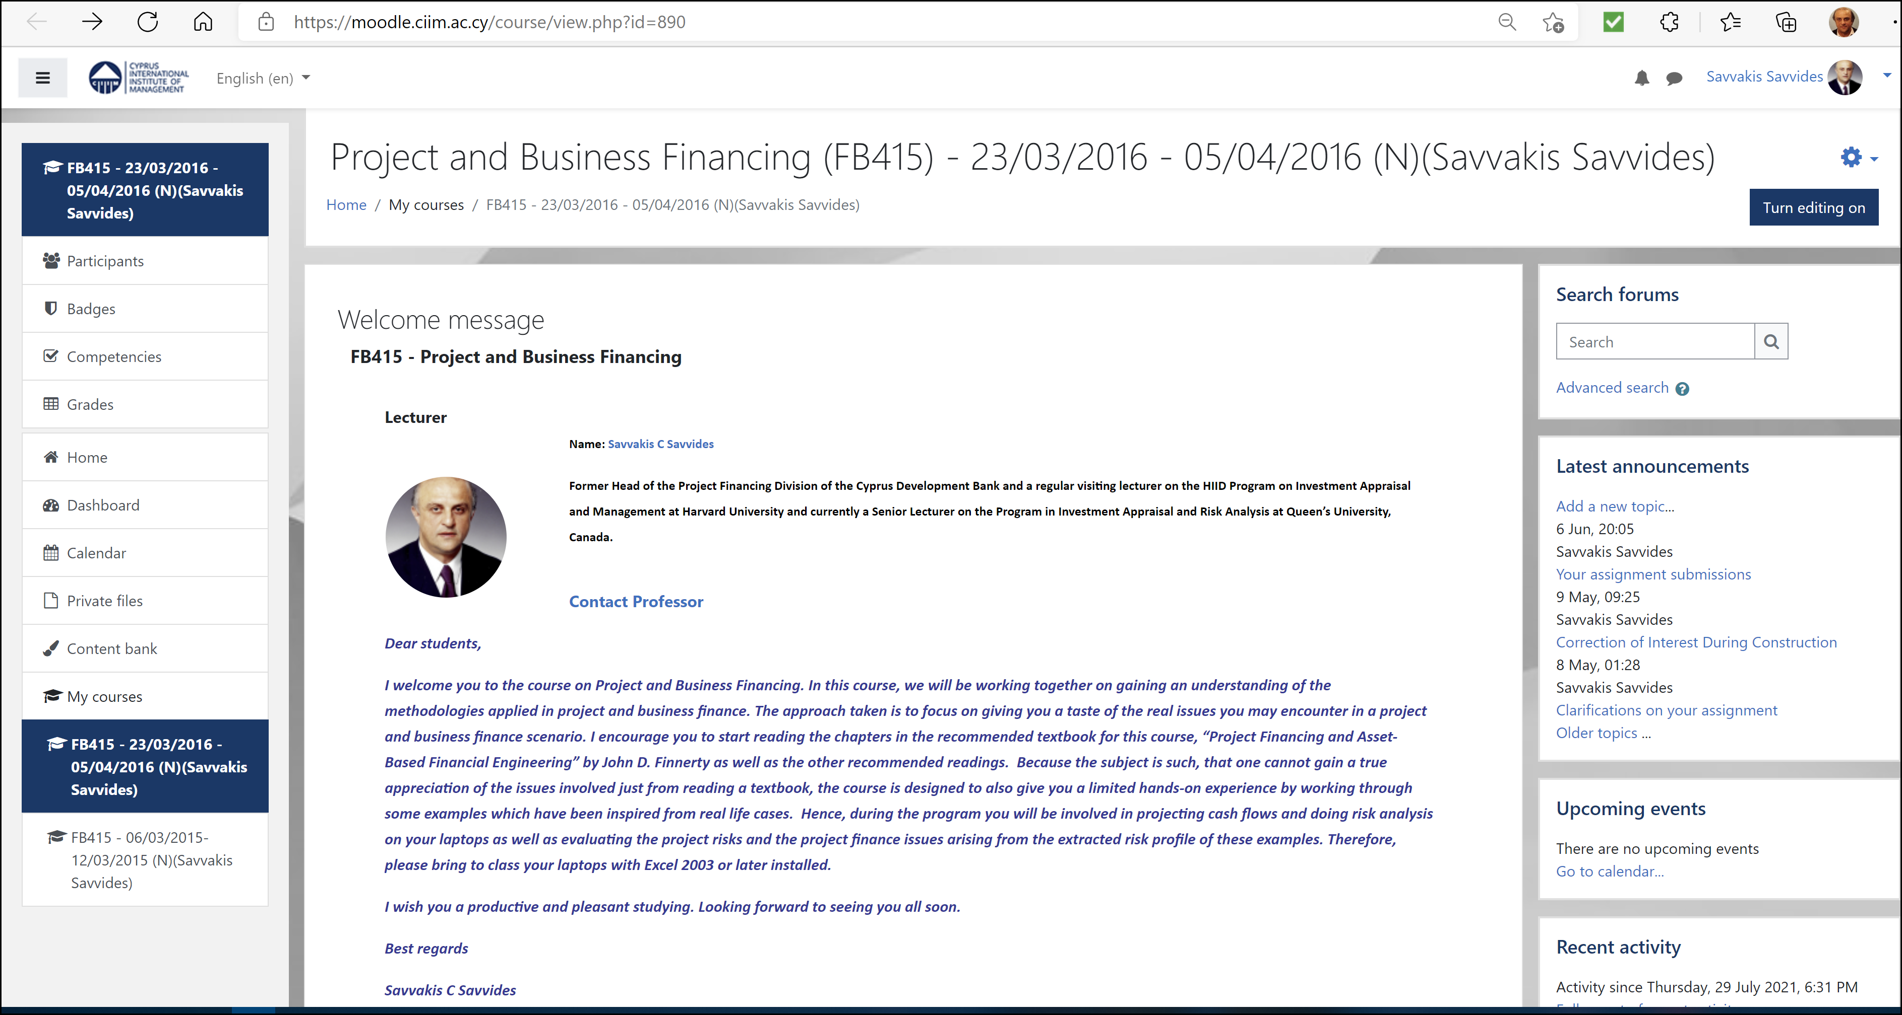
Project and Business Financing post graduate course
Program Director: Savvakis C. Savvides 2014-2016
Cyprus International Institute of Management

Slide 20
Project And Business Financing: Course Outline I
What is Project Financing?
– The Project (Risk and Return) and the Cart (the Financing)
– Project Financing is Cash Flow Financing
– Different Perspectives and Stakeholder Analysis
Cash Flow and Financial Modelling in Project Finance
– Development of Cash Flow Statements
– Integrated Financial Modelling and Projecting Cash Flow
Risk Analysis and Key Project Risk Categories
– What is Risk?
– Modelling and Forecasting Risk
– Risk Analysis using Monte Carlo Simulation
– Project Risk Categories and the Project Risk Profile
The Assessment of Project Competitiveness
– The Project Relevant Market
– A Framework for Assessing Project Competitiveness
– The Project’s Competitive Strategy

Slide 21
Project And Business Financing: Course Outline II
The Arrangement of Finance
– Project Finance and Risk Reduction
– Managing and Sharing Project Risk through Contracting
– Cash Flow Waterfall/Cascade
– Security Arrangement and Loan Documentation
– Syndicated Lending
Public Private Partnerships (PPP) and Megaprojects
– Project Finance and the Public Interest
– Stages of a Public Private Partnership
– Megaprojects and Risk
Project Finance Cases and Examples
– Hotel, Golf Resort, Marina, Satellite Telephony, Mall, Road

Slide 22
Project And Business Financing
Program Readings
Andreou_Savvides-Paphos-Holiday-Complex-Case-Study
Armstrong-Syndicated-Loans-Bank-of-Canada
Bain-Transportation
Finnerty-Chapter5-Analyzing-Project-Viability
Finnerty-Chapter6-Designing-Security-Arrangements
Glenday-Risk-Sharing-Contracts-in-Project-Appraisal
Integrated-Project-Appraisal-Spreadsheet-Example
Jenkins-CBA-Chapter03-Financial_Aprraisal
Jenkins-CBA-Chapter06-Risk
Jenkins-CBA-Cost-benefit_analysis_for_investment_decisions
Jenkins-Evaluation-of-Stakeholder-Impacts
RiskEase-Investment-Analysis-Toolpak-Manual
Savvides-Corporate-Lending-and-the-Assessment-of-Credit-Risk
Savvides-Market-Analysis-and-the-Assessment-of-Competitiveness
Savvides-Risk-Analysis-in-Investment-Appraisal
Yescombe-Chapter-1-What-are-PPPs
Yescombe-Chapter-8-Project-Finance-and-PPPs

Slide 23

Marketing Analysis and the
Assessment of Competitiveness
Savvakis C. Savvides
Notes:
23
23

Slide 24
A market analysis should reveal:
  what are the fundamental needs that the project aims to satisfy,
  what are the key choice factors on which consumers decide which product or service to buy,
  what customer groups is the product or service of the project likely to appeal to and why,
  which are the main suppliers/competitors currently providing products and services which aim to satisfy this market need.

Slide 25
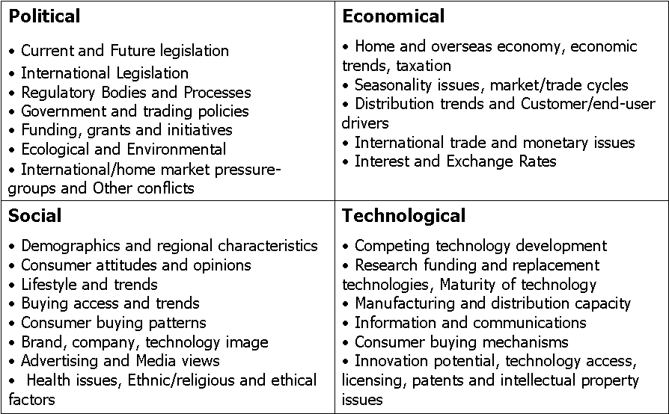
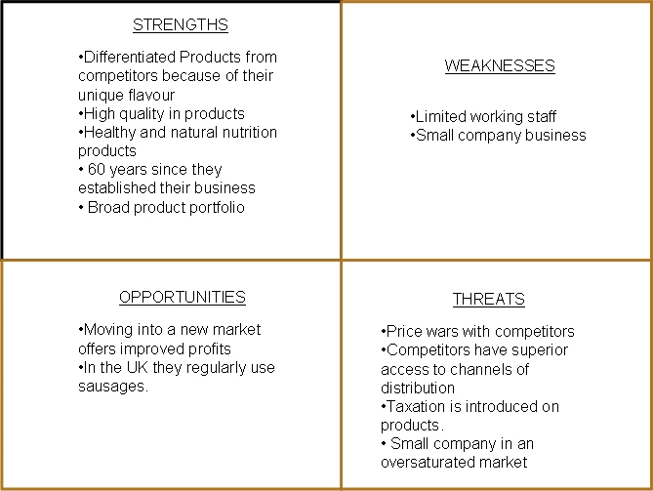
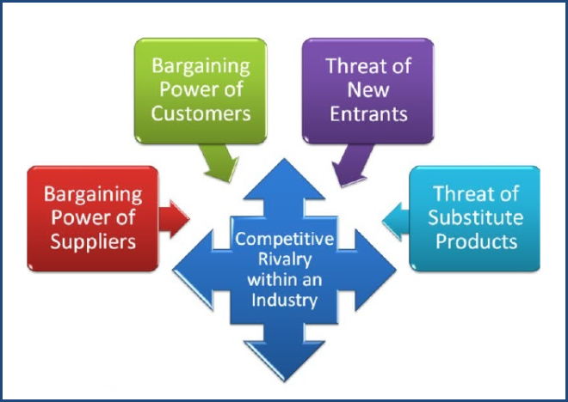
Conventional methods for assessing competitive strategy
PEST ANALYSIS
SWOT ANALYSIS
FIVE FORCES INDUSTRY ANALYSIS

Slide 26
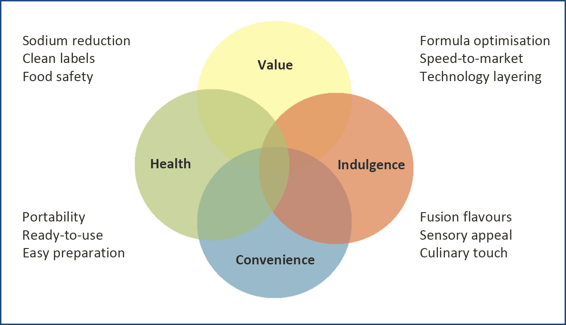

Typical Outcome of Competitive Strategy Analysis
Kerry’s Strategic Positioning
Source: Goodbody Conference, “Kerry Group in Changing Times”
http://www.kerrygroup.com/investor_index.asp, Oct. 2010

Slide 27
A successful project is one that matches
Resources and Capabilities to Market Needs
Resources and Capabilities
Market
Needs
Notes:
27
27

Slide 28
A Market based Framework for assessing Project Competitiveness in Cost Benefit Analysis
Turning Product Features into Customer Benefits
Price
Market Positioning
Supply
Capabilities
P1
Market
Needs
P0
Features
Benefits
Supplier Costs
Net Customer Value
Demand
Market Competence
Q0
Q1
Quantity
Notes:
28
28

Slide 29
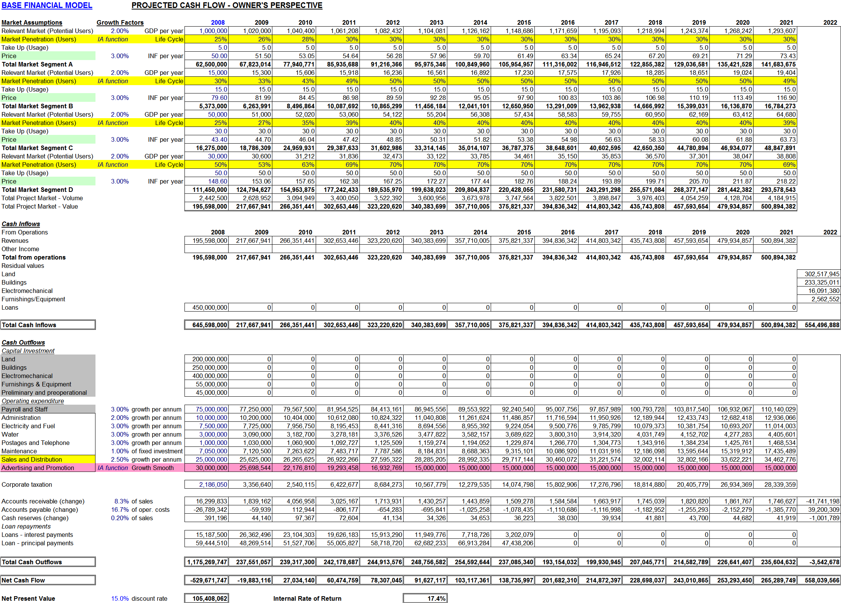
Projected Cash Flows
Price
Mix
Promotion
Mix
Place
Mix
Product
Mix
Notes:
29
29

Slide 30
The Project’s
Competitive Strategy
Notes:
30
30

Slide 31
The Project’s Competitive Strategy Matrix
+ Costs
Doom strategy
Differentiation strategy
+C -B
+B>+C
Increase in Benefits greater than increase in Costs
- Benefits
+ Benefits
Cost Leadership strategy
Hybrid strategy
-C>-B
-C+B
Reduction in Costs greater than reduction in Benefits
Reduction in Costs with increase in Benefits
- Costs
Notes:
31
31

Slide 32
Checklist of questions to test the robustness of the projections
What is the market need the projects aims to satisfy?
What is the project relevant market?
What is the market size?
How is the market segmented?
Who are the project's prime competitors?
Which are the project capabilities?
What is the target market of the project?
What is the market performance gap the project will fill?
How is the project positioned in the market?
What is the competitive advantage of the project?
Is the competitive advantage sustainable?
Will the project generate net customer value and a market expansion?
Do the cash flow projections accurately reflect the marketing analysis findings and the selected competitive strategy for the project?
Notes:
32
32

Slide 33
Conclusions (and things to remember):
You do not build a project and then look for a market.
You first identify a performance gap in the market for which you can attain a competitive advantage and then formulate the project around this.
For any competitive strategy selected it is imperative to identify the key success factors and critically assess whether the project as formulated and with the resources and capabilities it has at its disposal can satisfy these.
The capital investment and operational business plan change with the selection of a particular target market and competitive strategy.
The underlying business plan as expressed in the projected cash flows should remain coherent and consistent during a Monte Carlo Simulation.
Notes:
33
33

Slide 34
The strategic appraisal of the project must answer two fundamental questions:
What is the project’s competitive advantage?
Is it sustainable over the life of the project?
Notes:
34

Slide 35

Software Tools
RiskEase Ltd
Notes:
35
35

Slide 36
Projecting Growth

Slide 37
Projected Growth Patterns
Growth Pattern
Formula
Input parameters
Linear
Value Year 0
Growth rate
y = a + bx
Exponential
-x/t
Starting value
Growth margin
Time scale
y = a + (b-a) (1-e )
Cyclical
Value Year 0
Growth rate
Amplitude
Period
Shift
x
2pi(x+b)
y = y (1+r) + ½ a sin
0
T
Notes:
37
37
Investment Analysis Module – RiskEase. For example, a cyclical projection can easily be plotted simply by providing five parameters to the “CYCLICAL” function (base, growth rate, amplitude, period and shift).

Slide 38
Projecting trends from analysing historical data
Prices of fertilisers 20 years prior to introduction of the project
250
200
Prices
150
Projecting steep positive or negative trends may mask the true risks and severely distort the decision to undertake the project or not.
100
50
0
0
5
10
15
20
Years
historical data
cyclical pattern
growth line
Notes:
38
38

Slide 39
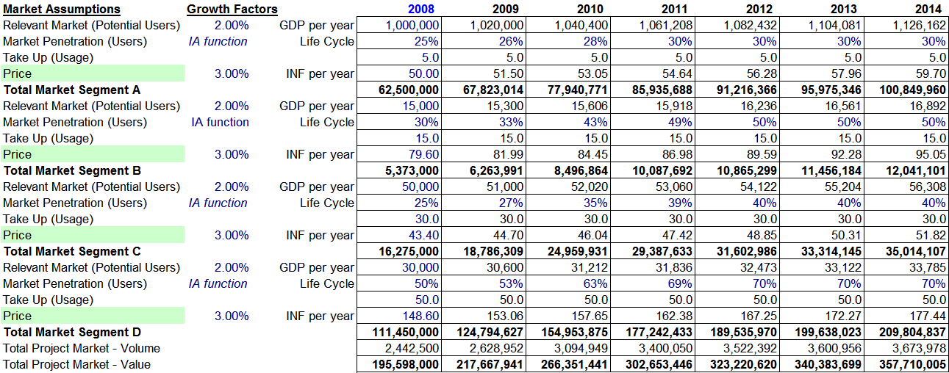
Market Penetration Growth Projections
Penetration (Users) - Market Segment A
31.0%
30.0%
29.0%
28.0%
27.0%
26.0%
25.0%
24.0%
23.0%
22.0%
2008
2009
2010
2011
2012
2013
2014
2015
2016
2017
2018
2019
2020
2021
Notes:
39
39

Slide 40
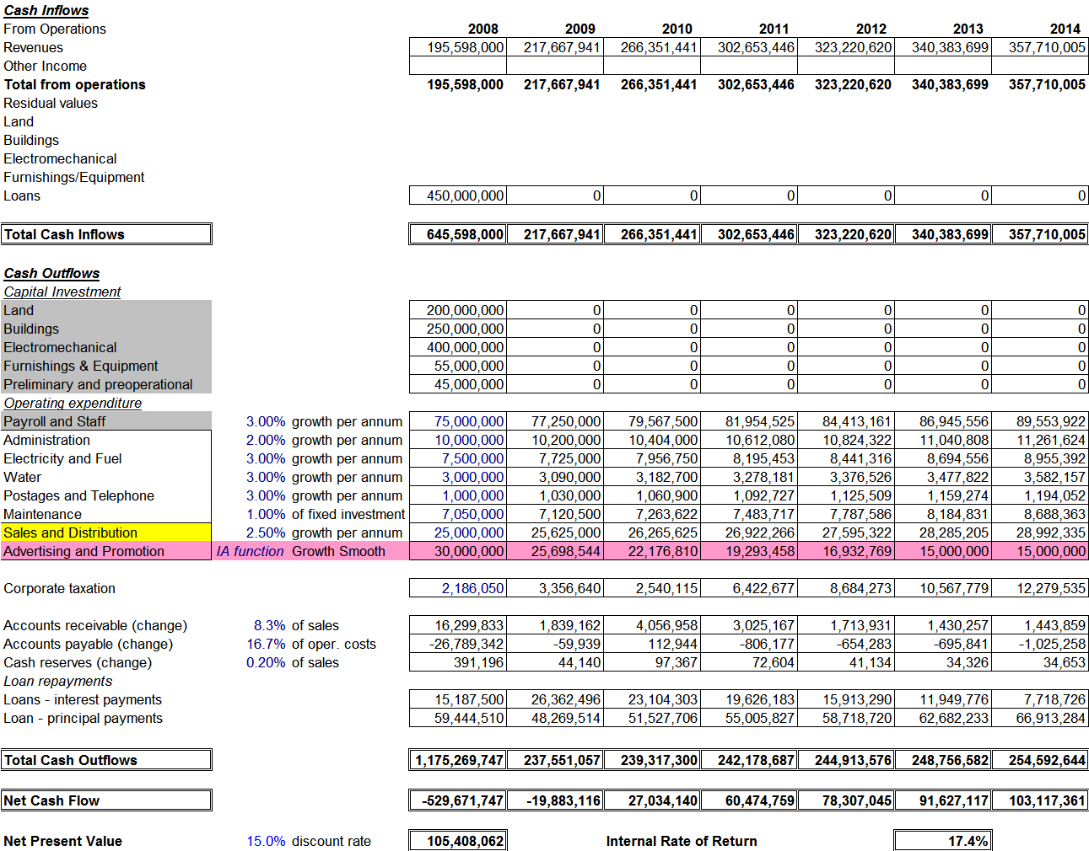
Projected Revenues
Advertising and Promotion
35,000,000
30,000,000
25,000,000
20,000,000
15,000,000
10,000,000
5,000,000
0
2008
2009
2010
2011
2012
2013
2014
2015
2016
2017
2018
2019
2020
2021
Notes:
40
40

Slide 41
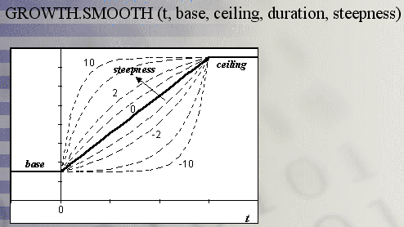
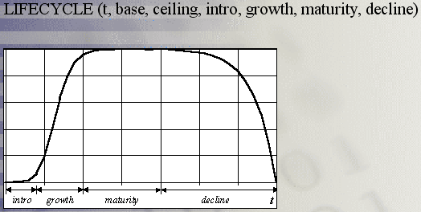
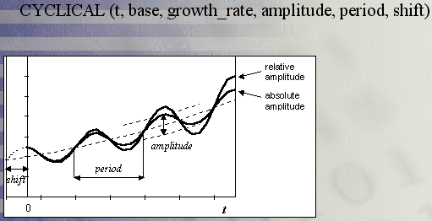
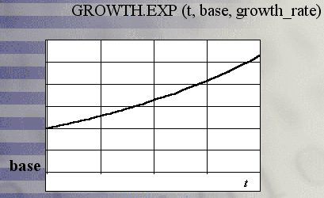
Investment Analysis Toolpak
Excel Functions

Slide 42
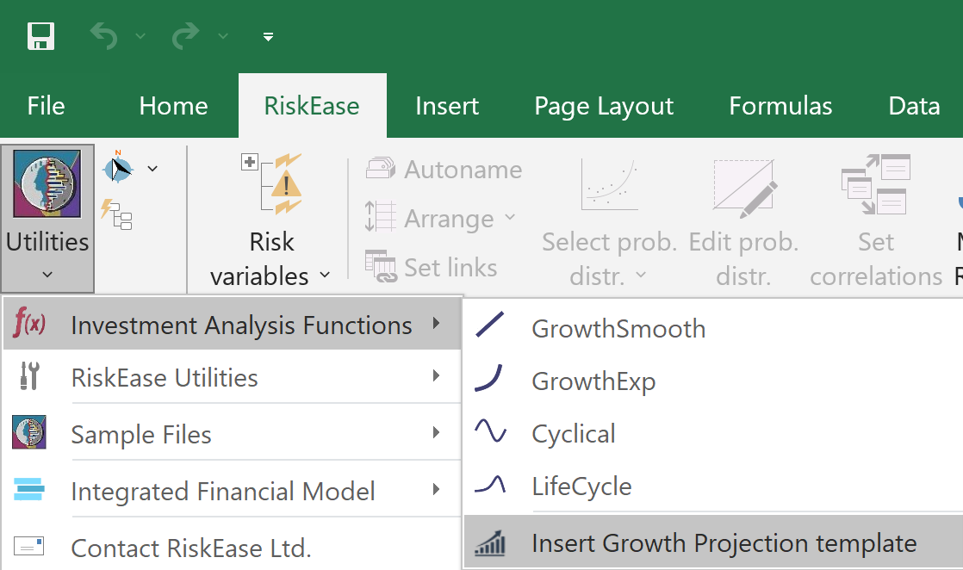
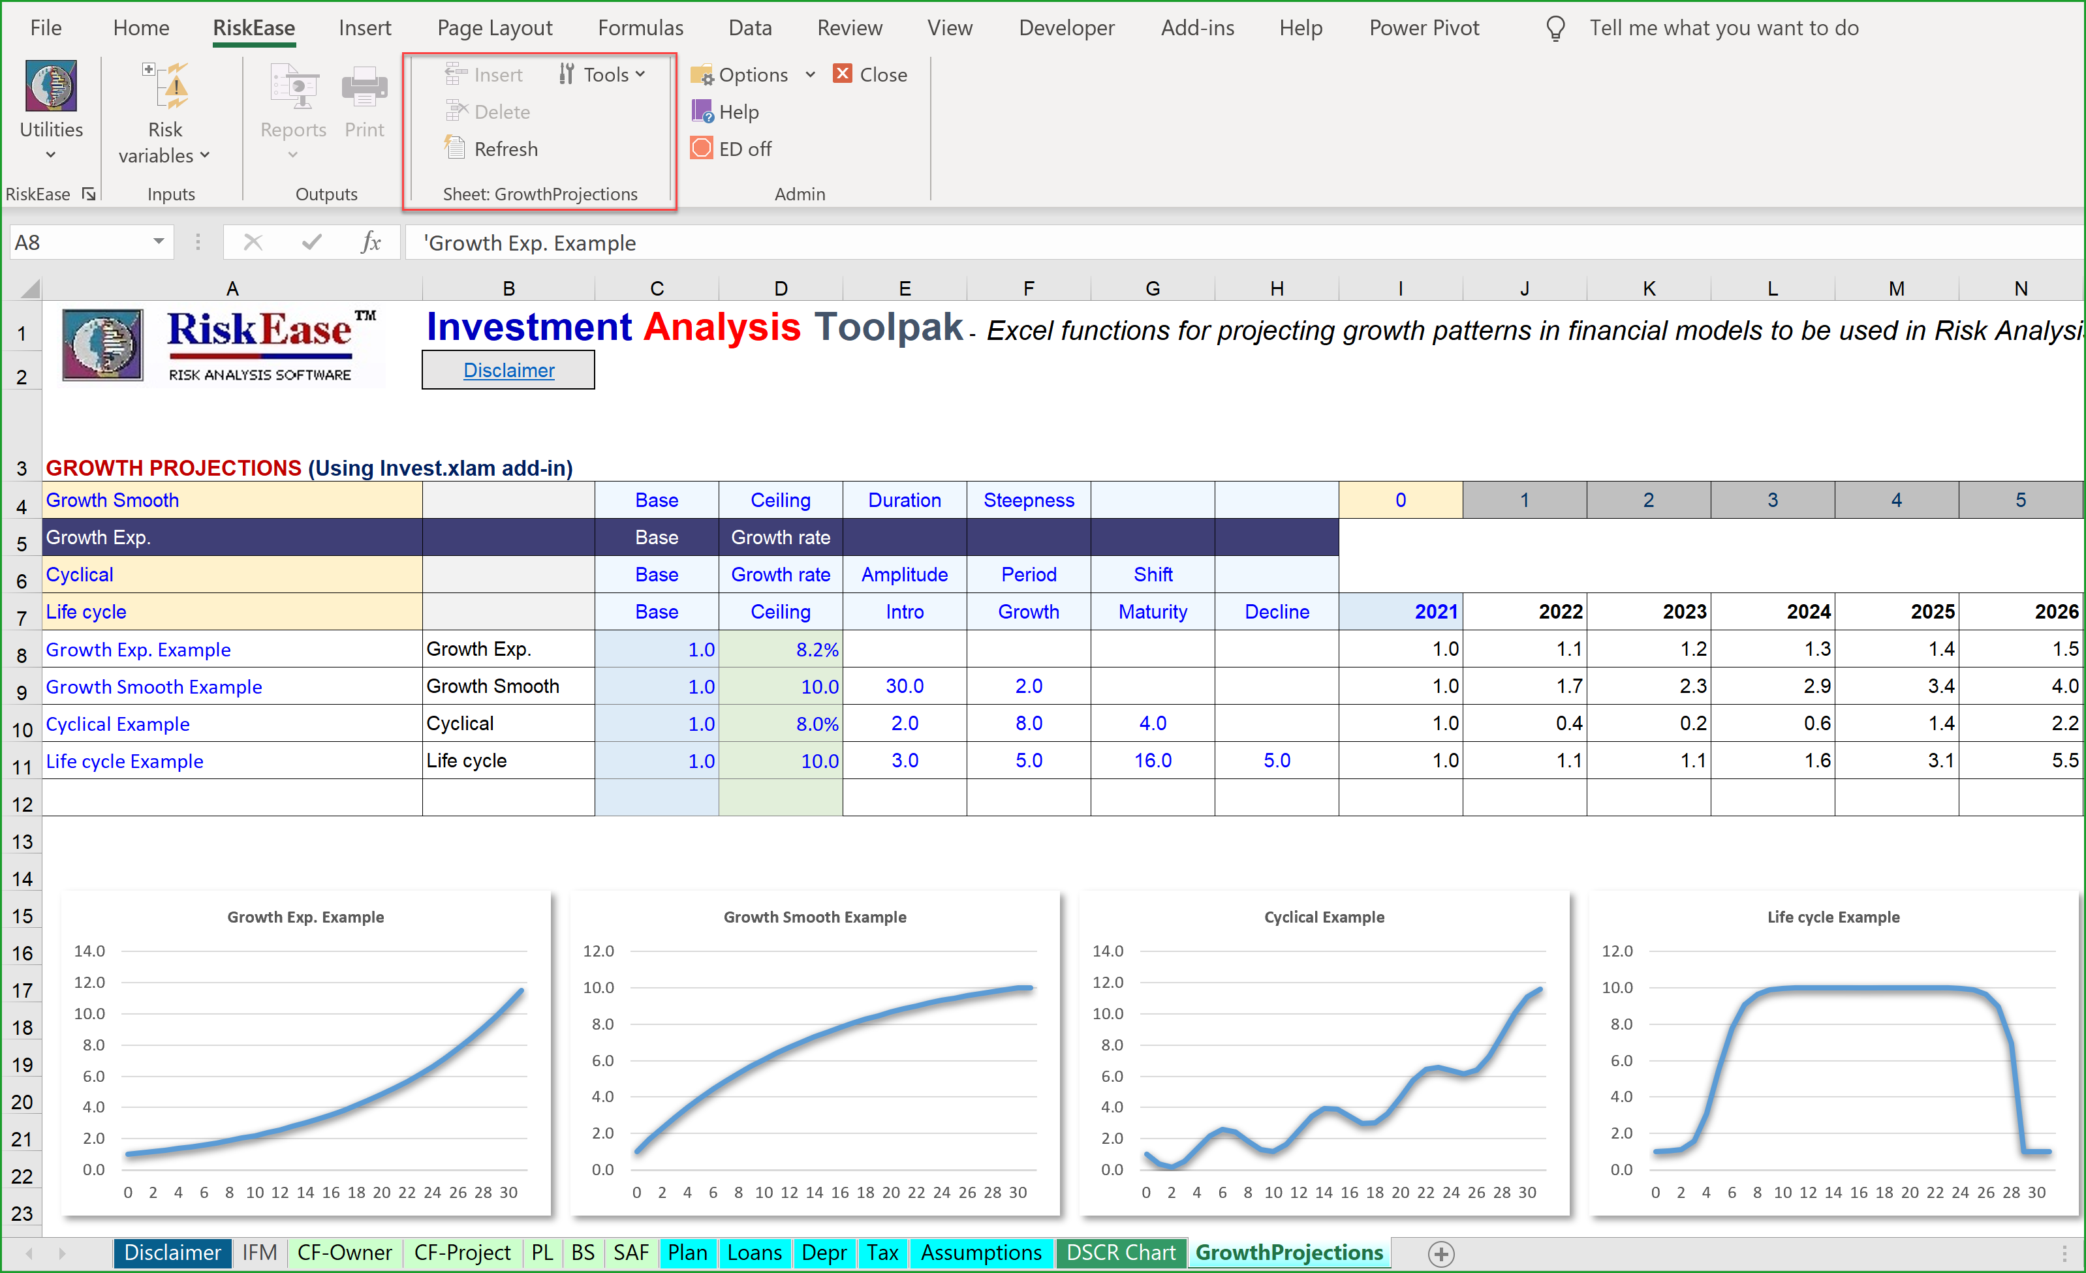
REGrowth
The Growth Projections Template

Slide 43
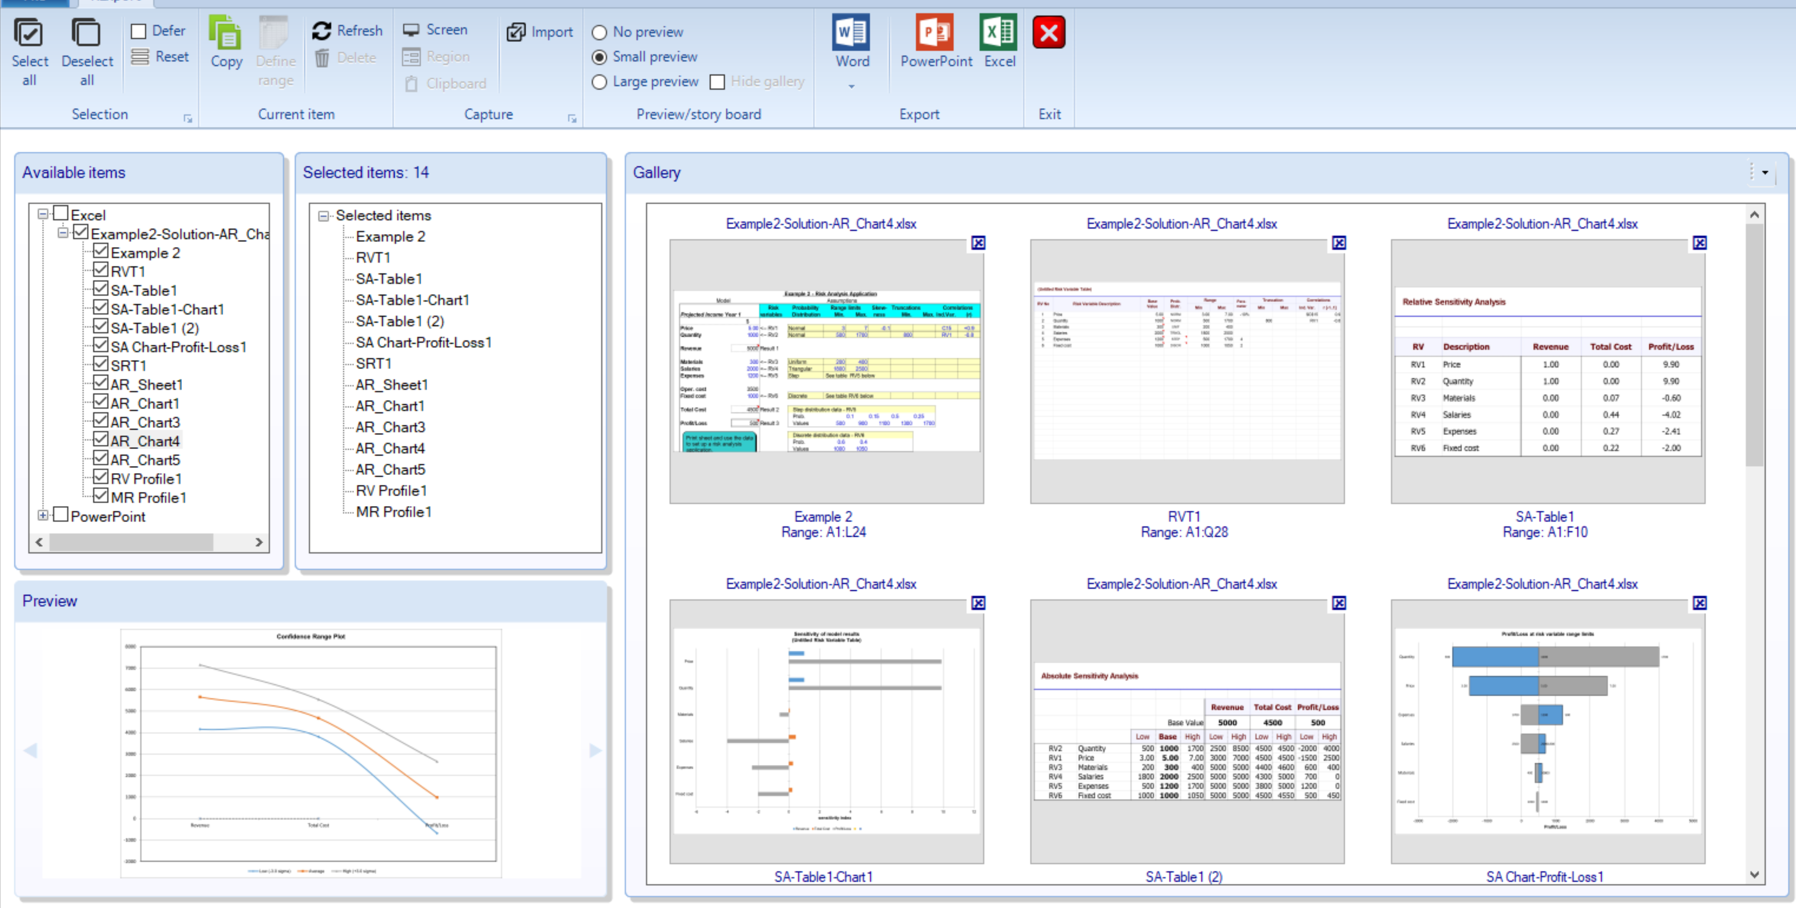
RExport
RiskEase Report and Export utility
Easily create custom Reports in Word, PowerPoint or Excel with drag-and drop.
Easily export Reports to Word, PowerPoint or Excel.
Gather and Preview objects (tables, sheets, charts and images) from many sources.

Slide 44
REMaps
RiskEase Workbook Map utility
Motorway Project
Financial sheets
Traffic
Ed
CF-Owner
CF-Project
PL
BS
SAF
Plan
Loans
Depr
Tax
Assumptions
RVTwo
SEN-Rwo
SEN-Rwo-Chart1
SEN-Awo
SEN-Awo-Chart1
SEN-Awo-Chart2
SRTwo
ARwo
ARwo_Chart1
ARwo_Chart2
ARwo_Chart3
ARwo_Chart4
Profile reports
RVPwo
MRPwo
RVTwg
SEN-Rwg
SEN-Rwg-Chart1
SEN-Awg
SEN-Awg-Chart1
SEN-Awg-Chart2
SEN-Awg-Chart3
SRTwg
ARwg
ARwg-Chart1
ARwg-Chart2
ARwg-Chart3
ARwg-Chart4
ARwg-Chart5
ARwg-Chart6
Profile reports
RVPwg
MRPwg
SRT (cmb)
AR (cmb)
AR (cmb)-Chart1
AR (cmb)-Chart2
AR (cmb)-Chart3
AR (cmb)-Chart4

Slide 45

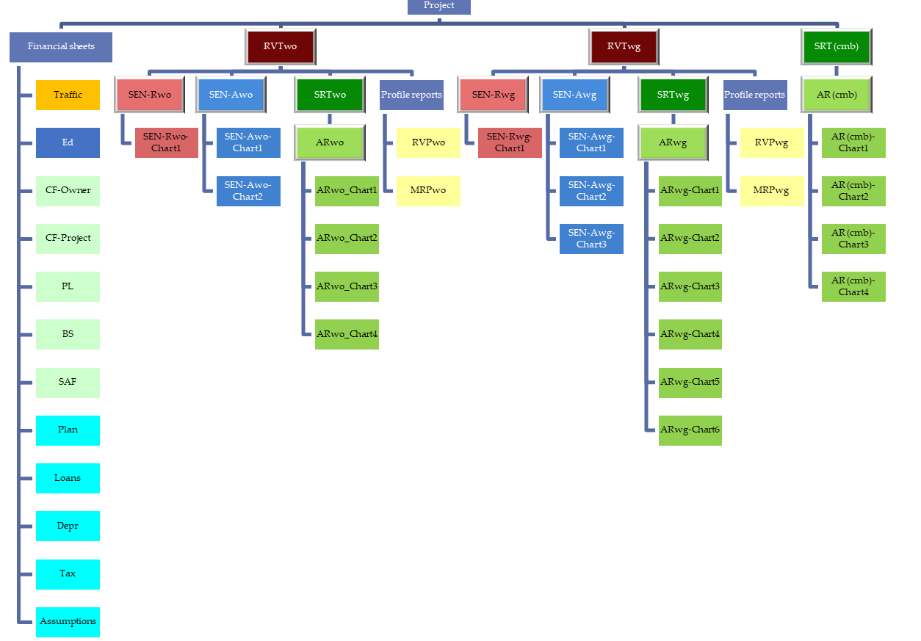
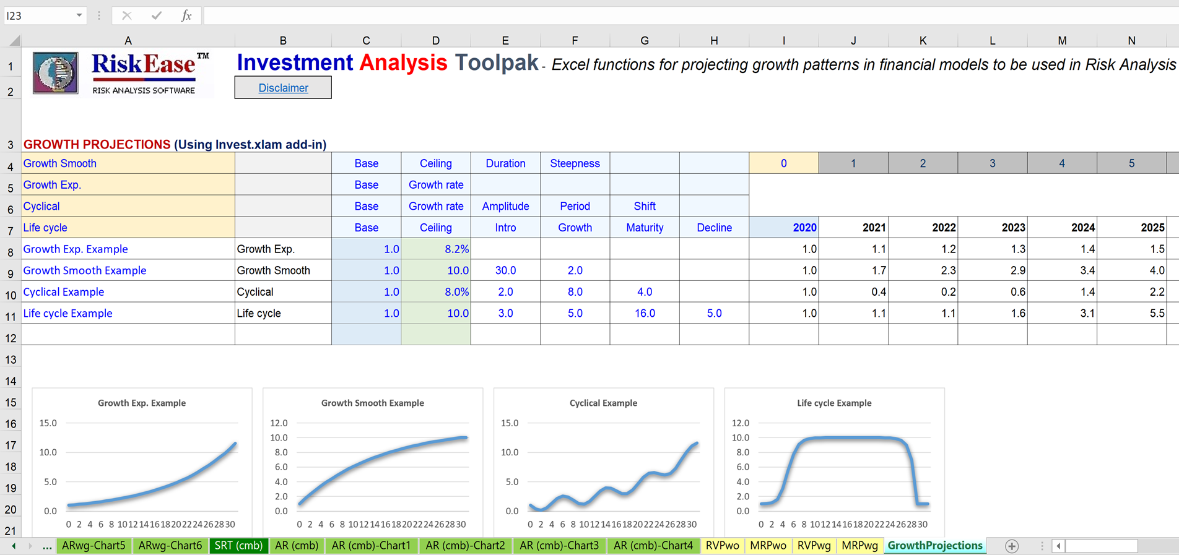
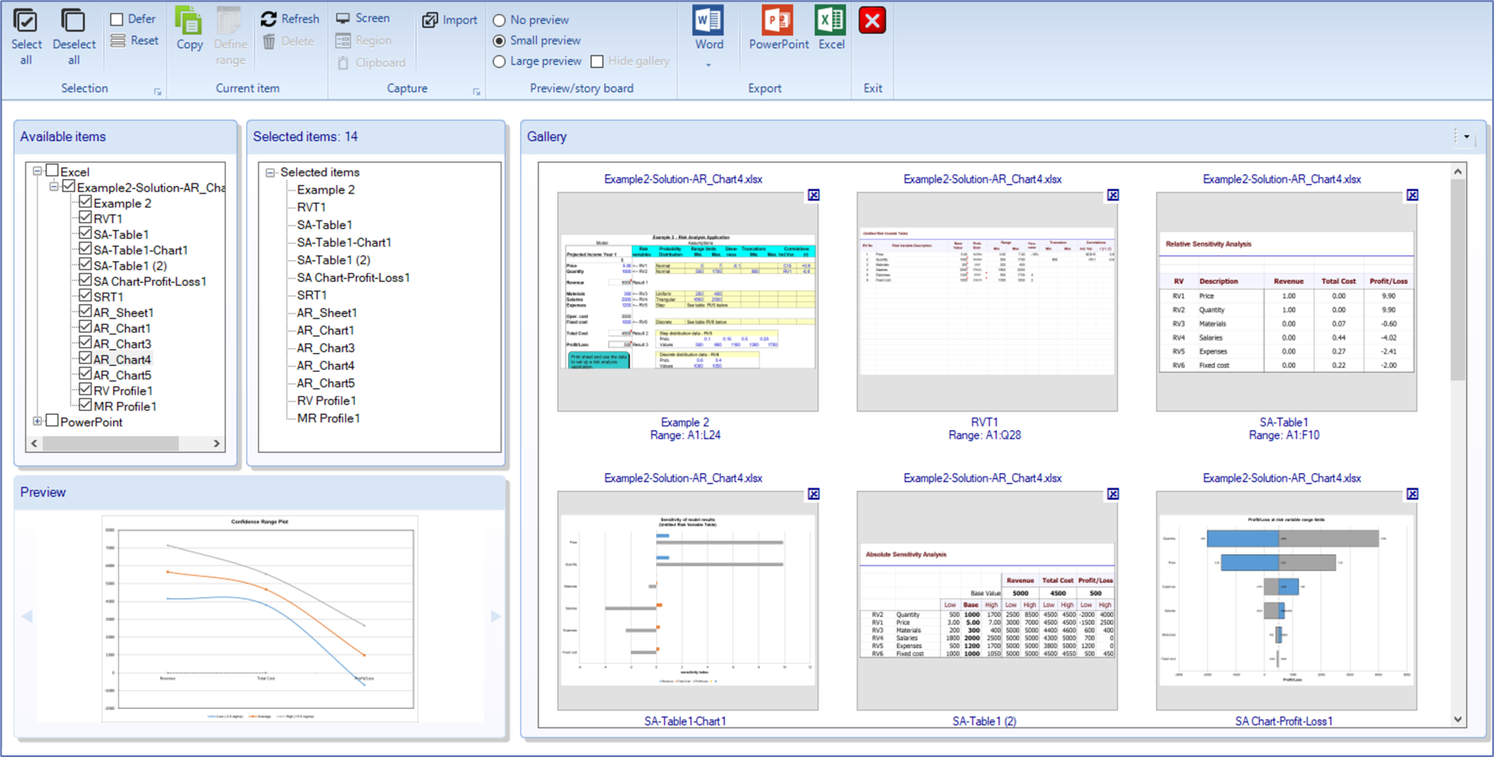
A complete package for the assessment of risk and return and for providing expert project finance solutions
Investment Analysis ToolPak
RiskEase – Risk Analysis Software
Training
Case-studies
Expert advice
Integrated Financial Model
REMaps
RiskEase Workbook Map utility
REGrowth
RiskEase Growth Projections Template
RExport
RiskEase Report and Export utility

Slide 46
Program in Investment Appraisal and Project Finance
1. Cost Benefit Analysis Methodology and Cash Flow Projections
Development of cash flows for new Project or existing Business
Different cash flow perspectives
Scale, timing, inflation and residual value decisions
Project Return - Uses and limitations of different investment criteria
Credit Risk Assessment and evaluation of debt service capability
2. Competitiveness Appraisal
Assessing and modelling market competitiveness
Integrated Financial Model and Modelling Tools
3. Risk Analysis
Risk assessment techniques
Defining and quantifying risk variables
Monte Carlo Simulation using RiskEase
4. Project Risk Profile and Project Financing
Project financing concepts and structuring of finance
Public Sector Projects and Public-Private Partnerships

Slide 47



Evaluating and assessing project risk
Theory and practice at the top level
©
Over 35 years of expertise in
project finance and corporate lending

Slide 48
A huge library of real projects
and Case-studies available
On-the-field expertise
Specialising in professional financial software tools and training for the assessment of risk and return and in providing practical solutions in capital investment decisions in corporate lending and project finance.
☑
RiskEase Ltd
Assess Risk with Ease

Slide 49

Useful Links
Affiliations:
Program in Investment Appraisal and Risk (PIAR) at Queen's University
John Deutsch International (JDInt’l) at Queen’s University
Risk Analysis Software:
RiskEase Demo Video
RiskEase Trailer Video
RiskEase Website
Risk Management Tools
Business Risk Analysis Solution Providers
Our partners:
Publications:
SSRN Author Page - Savvakis C. Savvides
EconPapers - Savvakis C. Savvides
Research Papers in Economics - Savvakis C. Savvides

